Slide 1




The Green AI Profiler
Navigating the Intersection of Performance and Sustainability
By Raghav Kapoor, Aditya Agrawal and Jayanth Siddalingappa
A novel recommendation engine that helps developers build powerful AI systems with minimal environmental impact.

Slide 2

The Hidden Cost of Intelligence
Massive Energy Consumption
Lack of Integrated Tools
No single tool holistically analyses a project's needs and provides actionable recommendations balancing performance with sustainability.
Training a single large AI model can emit more carbon than five cars in their lifetimes. GPT-3 training consumed nearly 1,300 MWh of electricity, resulting in over 550 tons of CO₂ emissions.
Decision Paralysis
Developers focus on accuracy, latency, and cost, lacking visibility into environmental impact of their technology choices.

Slide 3

Key Decisions Without Environmental Context
Which model architecture is most efficient?
Which hardware is best?
Which data centre region is greenest?
NVIDIA A100 vs. H100 vs. Google TPU
Renewable vs. fossil fuel powered
BERT vs. Distil BERT vs. ALBERT
Different parameter counts
Different power profiles
Regional energy grid differences
Varying computational requirements
Varying performance characteristics
Significant carbon impact variations

Slide 4
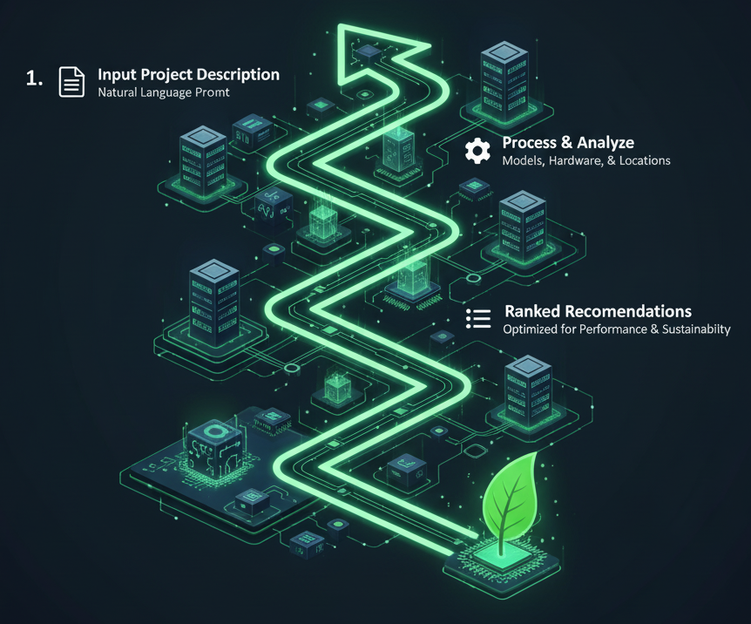



Introducing: The Green AI Profiler
A self-service tool that makes sustainable AI an easy choice, not a difficult one. Think of it as Google Maps for your AI project; finding the most efficient route considering both performance and carbon footprint.
Input Project Description
User provides a natural language prompt describing their AI project requirements
Process & Analyze
System analyzes combinations of models, hardware, and locations
Ranked Recommendations
Returns optimized solutions balancing performance and sustainability

Slide 5

Sample Recommendations
Option 1: Most Eco-Friendly
Option 2: Balanced Approach
Model: Llama-3-8B-Instruct (Quantized)
Model: Mistral-7B-Instruct-v0.2
Hardware: NVIDIA L4 GPU
Hardware: NVIDIA A100
Data Centre: Google Cloud - europe-west1 (Belgium)
Data Centre: AWS - ca-central-1 (Canada)
Reasoning: Excellent balance of performance. The L4 GPU is highly power-efficient, and Belgium's region has very low carbon intensity due to nuclear and renewables.
Reasoning: Higher performance with the A100, and Canada's grid is largely powered by hydropower, offering a good compromise between raw power and sustainability.

Slide 6
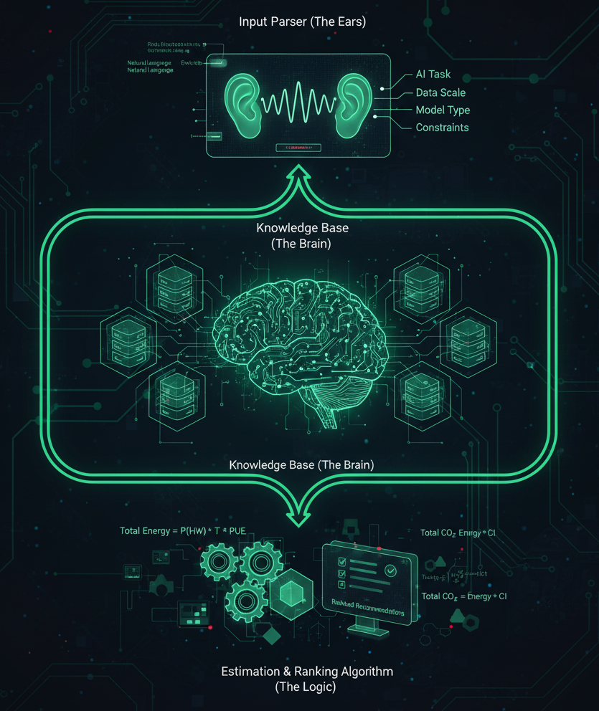
How It Works: The Recommendation Engine
Input Parser (The Ears)
Uses a Language Model to parse the user's prompt and extract key entities: AI Task, Data Scale, Model Type, and Performance Constraints.
Knowledge Base (The Brain)
A continuously updated database containing AI Models information, Hardware Specs, and Data Centre Grids with real-time Carbon Intensity data.
Estimation & Ranking Algorithm (The Logic)
Calculates key metrics for each combination:
Total Energy (kWh) = (Hardware Power Draw * Training Time) * PUE, and Total Carbon Footprint (kgCO₂) = Total Energy * Carbon Intensity.

Slide 7
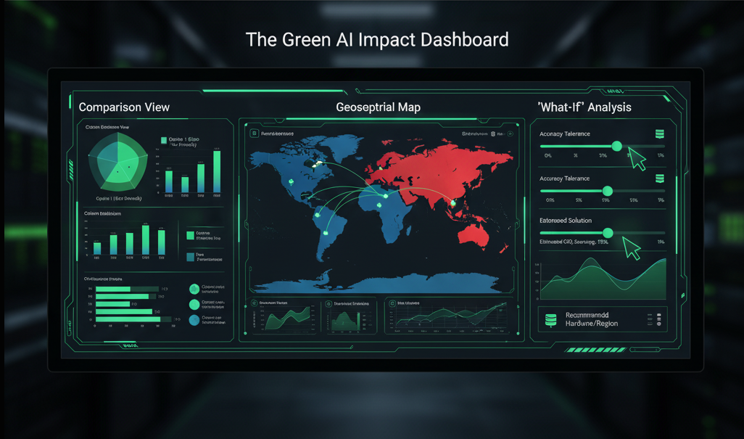
The Dashboard: Visualizing the Green Impact
Comparison View
Geospatial Map
"What-If" Analysis
Bar charts or radar charts compare the top 3-5 recommendations across key axes: Carbon Emissions, Estimated Cost, Training Time, and Performance Score.
A world map color-coded by real-time carbon intensity of electrical grids, visually showing why choosing a data centre in Finland might be better than one in Virginia.
Interactive sliders show how recommendations change if constraints are adjusted. For example, "What if I can tolerate 5% lower accuracy?"

Slide 8
Implementation Plan & Tech Stack
Frontend
Backend
Prompt Parsing
Streamlit or Gradio for rapidly developing a proof-of-concept UI, allowing users to interact with the profiler.
Python with Flask or Fast API to serve the core logic and handle API requests.
SOGPT API or any other LLM for state-of-the-art natural language understanding to accurately parse user project descriptions.
Knowledge Base
Data Visualization
Initial version using static CSV or JSON files containing pre-compiled data for popular models, hardware, and cloud regions.
Plotly or Altair libraries to render the interactive charts and maps for the dashboard.

Slide 9
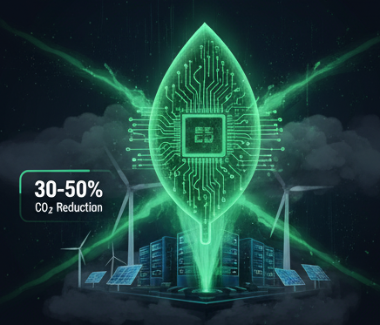
Impact and Future Scope
Immediate Impact
Future Scope
Empowers developers to make data-driven, sustainable choices, potentially reducing the carbon footprint of new AI projects by 30-50% or more.
Real-time Monitoring: Integrate with cloud provider APIs to track actual energy consumption
MLOps Integration: Develop plugins for Kubeflow, MLflow, and Weights & Biases
Inference Optimization: Expand to recommendations for model deployment
Embodied Carbon: Include manufacturing carbon cost for true cradle-to-grave analysis

Slide 10


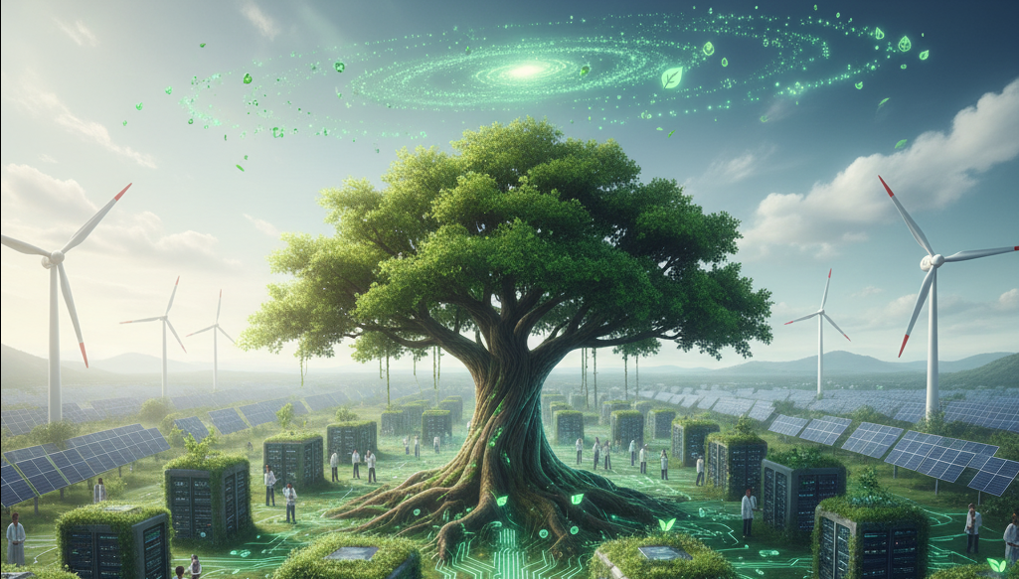
Making "Green AI" the New Standard
By building the Green AI Profiler, we are not just creating a tool; we are fostering a culture of sustainability within the AI community.

